Slide 1
Duty of Care
3
Standard

Slide 2
Learning outcomes
3.1 Understand how duty of care contributes to
safe practice
3.2 Understand the support available for addressing dilemmas that may arise about duty of care
3.3 Deal with Comments and complaints
3.4 Deal with Incidents, errors and near misses
3.5 Deal with confrontation and difficult situations.
3
Standard

Slide 3

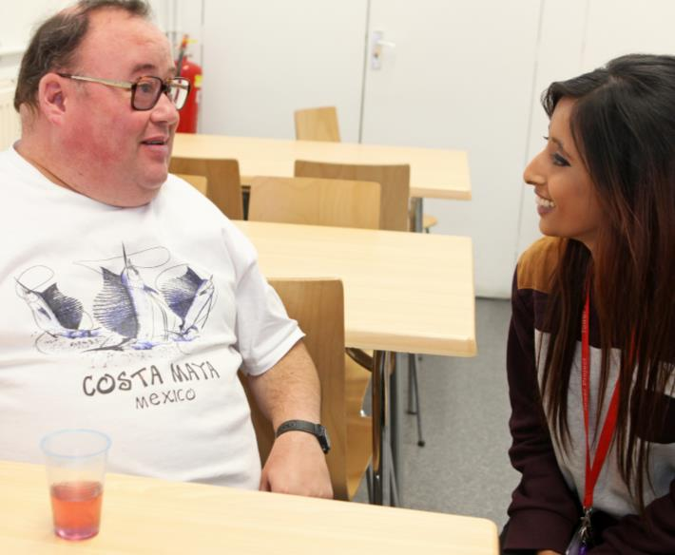

What is a duty of care?
You have a duty of care to all those receiving care and support in your workplace
A Duty of Care is the duty
to promote wellbeing and make sure that people are kept safe from harm, abuse and injury
Wellbeing
Wellbeing could be defined as the positive way in which a person feels and thinks
of themselves.
Notes:
Question
What do we mean by a “Duty of Care”?
Answers could include:
Promoting rights
Promoting wellbeing
Safeguarding/keeping safe from harm, abuse and injury.
Additional information
A Duty of Care is a legal requirement; workers cannot choose whether to accept it. Breaking this duty, for example through negligence, could result in legal action
The duty of care is part of ‘The Code of Conduct for Healthcare Support Workers and Adult Social Care Workers in England’
Workers have a duty to the people they provide support to and the people that they work with
The Duty of Care will usually be included in the worker’s job description.

Slide 4

What do I need to do?
Workers must have the knowledge and skills to act on their duty of care. Workers must be able to:
Identify areas of concern
Report concerns in agreed ways
Your manager will be able to advise you of what to do if you
are unsure.
Notes:
Additional information
Examples of things which could cause concern include:
Poor working conditions (hours, pay etc. that do not meet legal requirements)
Unsafe equipment (e.g. hoists that are not checked regularly)
Unsafe working practices (e.g. care plans and agreed ways of working not being followed)
Suspected abuse (e.g. rights not being upheld and dignity not being promoted).

Slide 5

Supporting independence
Workers must:
Respect and protect individuals’ rights
Promote individuals’ independence
Enable the person to make an informed choice.
Notes:
Additional information
Individuals have the right to be treated fairly, with dignity and to have some control of their lives
Workers must always work in ways that protect the legal rights of the individuals that they support
Individuals must be supported to live their lives as independently as possible, making informed decisions and being involved in decisions about their care
Workers should only act within their roles- if they are in any doubt about a situation they should speak to their manager.

Slide 6
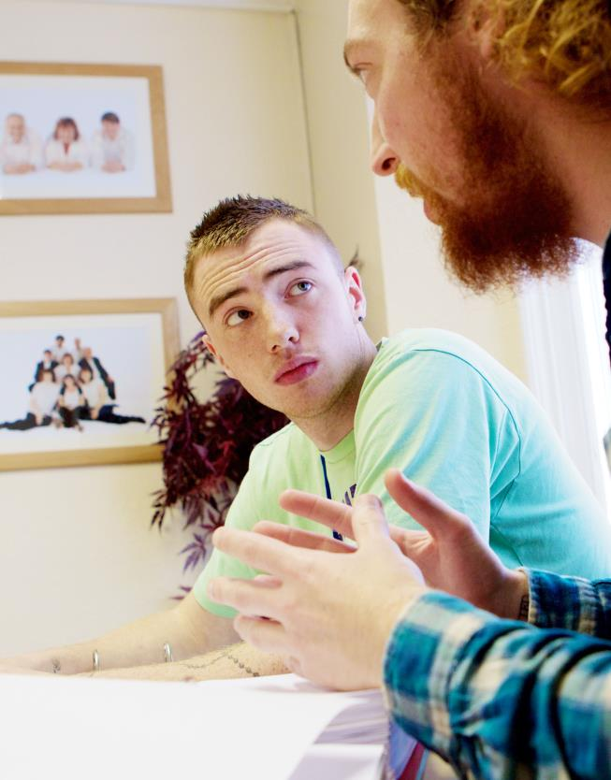
Dilemmas
There may be a conflict between protecting a person’s rights and independence and their safety and wellbeing. This can lead to dilemmas.
It may be necessary to balance:
Their right to make choices
The need to protect individuals from harm.
Notes:
Discussion:
Pick a scenario that is appropriate to the workplace (use one from the list or pick your own)
A person with a disability wants to take part in a new physical activity
A person chooses to eat a fatty and unhealthy diet
A person chooses not to take their medication
A person with dementia wants to go out alone.
Question:
What should you do if an individual you are supporting makes a decision that is unwise?
Suggested answers include (will depend on the scenario chosen):
Giving the person as much information about the decision as possible
Supporting the person to make an informed decision
Assessing the risks of each decision
Enabling the individual to make decisions that are risky by taking action to reduce the risks
Suggesting the individual discusses the decision with trusted people such as: friends, family, and advocate, their GP or their social worker
Recording the decisions on the individual’s care plan to make others aware
The worker discussing the matters of concern with their manager.

Slide 7

Mental capacity
Some individuals may not have the ability to:
Understand their choices
Make an informed decision
Understand what could happen
If decisions have to be made for an individual who lacks capacity, the decision made must be in their best interests.
Notes:
Additional information
The Act assumes that individuals can make decisions unless they are unable to do one or more of the following;
• Understand information given to them
• Retain information for long enough to be able to make the decision
• Weigh up the information available to make the decision
• Communicate their decision- individuals must be supported to communicate through all possible means.
A lack of capacity may not be permanent:
Infections can worsen symptoms of dementia meaning that they are temporarily unable to retain information for long enough to make and informed decision. When the infection clears they may be able to make a decision.
A person in a coma will be unable to communicate any decisions they make. When they wake from the coma they may have the capacity to make decisions.
An individual who is unable to make one decision may be able to make other decisions.
The individual may be unable to make complex decisions about finances or medical treatment but may be able to make day to day decisions about what to wear or what to eat.

Slide 8

Comments and complaints
The Duty of Care includes a duty to support individuals to make comments or complaints about their care.
Legislation and guidance relating to comments and complaints includes:
The Local Authority Social Services and NHS Complaints (England) Regulations 2009
The NHS Constitution in 2011
Your organisation’s agreed ways of working.
Notes:
Additional information
The Local Authority Social Services and NHS Complaints (England) Regulations 2009 sets out the legal requirements for local authority social care departments and NHS organisations when dealing with complaints.
The NHS Constitution in 2011 sets out the principles and values of the NHS. It establishes the rights which people have and how they can expect to be treated when dealing with the NHS.
Your organisation’s agreed ways of working set out the ways in which you should deal with comments and complaints. This will be specific to the workplace and is likely to include the forms or paperwork that should be used to record comments and complaints and the person who is identified to deal with them. (Where possible make sure that workers have a copy of the agreed ways of working for their organisation).

Slide 9
Supporting individuals to make a complaint
Provide a and quiet space for comments or complaints to be made
private
Inform the individual of the policy
confidentiality
to the individual, making sure that you do not
Listen
judge
Explain the procedure and their comments or complaints should be forwarded to
complaints
whom
Inform your so that they are aware of the situation
manager
Notes:
Question:
How should you respond if an individual you support wants to make a comment or a complaint about the care they are receiving?
Answers:
Discussion should include:
Providing a suitable environment so that the person feels able to communicate openly and honestly
Telling the individual the limits of confidentiality (specifically regarding to safeguarding)
How the worker should respond to the person (Listen calmly and actively, assuring them that you are taking them seriously, and remaining non-judgemental)
Explaining the complaints procedure- how complaints will be dealt with, who will deal with the complaints and what they can expect to happen next
What the worker needs to do once the complaint has been made.
Question:
When might it be necessary to provide additional support to enable individuals to comment or complain?
Answers:
Possible answers include:
If English is not the individual’s first language
If individual has literacy needs and needs support with reading or writing
If they need support with communication e.g. communication boards
If they need forms in a different format e.g. large print.

Slide 10
Incidents, errors and near misses
Mistakes must be dealt with appropriately so that similar things do not happen again.
Mistakes can be:
Adverse events
Errors
Near misses
Action or lack of action that leads to unexpected, unintended and preventable harm
Not doing something as it should have been done, for example through bad planning or being forgetful
Situations where an
action could have harmed the individual but, either by chance or purpose, was prevented
Incidents
Specific negative events. In health and social care serious incidents are described as events which need investigation as they caused severe harm or damage to either the person receiving care or the organisation.
Notes:
Additional information
Mistakes can happen because of:
Lack of worker knowledge or understanding
Poor communication between workers
Not sharing information
Stress
Negligence
Being distracted.
After an incident:
The first priority must be the meet the immediate needs of the individuals involved
An incident form should be completed giving the facts of what happened including date, time, who was involved and where the incident happened
Reports and incident forms SHOULD NOT include your opinions and should not blame anyone.

Slide 11
Legislation
When incidents happen, legislation sets out how to handle incidents. Relevant legislation includes:
The Health and Safety at Work etc.
Act 1974
The Management of Health and Safety Regulations 1999
The Reporting of Injuries, Diseases and Dangerous Occurrences Regulations 2013 (RIDDOR)
The Control of Substances Hazardous to Health Regulations 2002 (COSHH)
The Provisions and Use of Work Equipment Regulations 1998 (PUWER).
Notes:
Additional information
The Health and Safety at Work etc. Act 1974
This is the main piece of legislation covering occupational health and safety in the UK. It places a duty on employers and employees for the health, safety and welfare of persons in the workplace.
The Management of Health and Safety Regulations 1999
Workplaces should have a procedure in place for recording, reporting and evaluating all serious incidents. They should take measures to avoid them happening again.
The Reporting of Injuries, Diseases and Dangerous Occurrences Regulations 2013 (RIDDOR)
This places duties on responsible persons in the workplace to report specific workplace accidents, occupational diseases and specific dangerous occurrences or near misses to their local Health and Safety Executive (HSE).
The Control of Substances Hazardous to Health Regulations 2002 (COSHH)
This requires employers to assess the risks of potentially harmful substances and take precautions to minimise these. Examples include cleaning materials and medication.
The Provisions and Use of Work Equipment Regulations 1998 (PUWER)
Anyone responsible for work equipment should ensure that it is suitable for the job, well maintained, inspected regularly and only operated by well-informed and trained staff. Not doing this is a crime in the UK and needs to be reported immediately. If any person suffers harm as a result, the offender may be taken to court.

Slide 12
Conflict in the workplace
Conflict or challenging behaviour often happens as a result of distress or because needs are not being met.
Reasons could be:
Biological
Social
Environmental
Psychological.
Notes:
Question
Statistics show that workers in health and social care have higher than average risk of experiencing threats or violence in the workplace. Why do you think this is?
(HSE Statistics state 3.1% of healthcare workers and 3.4% of social care workers experienced violence or threat of violence in 2013/2014 www.hse.gov.uk/Statistics/causinj/violence/violence-at-work.pdf)
Possible Answers (answers will depend on the specific workplace
Health and social care workers work directly with people who may be:
Under stress
In pain
Feeling unwell
Experiencing side effects from medication or substance misuse
Having to wait for medical attention
Feeling frustrated because they are not in control of their lives or of a situation
Feeling frustrated because they are unable to communicate their needs
Feeling frustrated because they cannot move around freely
Feeling isolated or unable to take part in activities
Feeling lonely.
Possible reasons for conflict can be classified as:
Biological for example because an individual is in pain or suffering the side effects of medication or substance misuse
Social for example because of being bored, wanting social contact, having a need to be in control, not being able to communicate or understand what is being said
Environmental for example because of loud noise or bad lighting or barriers in the room to mobility
Psychological for example because of feeling left out.

Slide 13

Managing conflict
Acting on early signs of frustration and aggression can stop conflict developing into violence. Always treat the individual with respect and dignity. If possible and safe:
Take them to a quiet place
Ask questions and listen carefully
Take their feelings seriously
Try to agree a way forward.
Notes:
Additional information
Workplaces often have a policy that will set out how to deal with challenging behaviour.
Factual information about the incident will usually be recorded on a form. This is intended to be a factual account of the incident and SHOULD NOT include opinions or blame.
Details recorded will usually include:
The date and time of the incident
Where the incident happened
What happened
Who was involved
Whether anyone was injured
Whether medical assistance was required
Whether the police were called.

Slide 14







Knowledge check
A meal that has peanuts in it is served to an individual with a known peanut allergy. The mistake is spotted and swapped. What type of mistake is this?
Click to reveal answer
Adverse event
Near miss
Error
Incident
Notes:
QUESTION:
Ask group question then to answer A,B,C or D
Trainer should ask class why they chose the correct answer.

Slide 15


Knowledge check
Which of the following most accurately defines what is meant by ‘Duty of Care’?
Click to reveal answer
Restricting the rights of the individual to make sure that they are safe.
The duty to put people into care when their family is not able to take care
of them.
The duty to promote wellbeing and keep people safe from harm, abuse and injury.
Stopping people making decisions that you disagree with or that may be risky.
Notes:
QUESTION:
Ask group question then to answer A,B,C or D
Trainer should ask class why they chose the correct answer.
Feedback
A – The rights of individuals must always be respected when care is being provided.
B – People must be supported to maintain their independence for as long as possible.
C – A duty of care is the duty to promote wellbeing and to keep people safe from harm, abuse and injury.
D – People who have the capacity to make decisions can choose to make risky decisions or choices that you think are unwise.

Slide 16

Knowledge check
Which of the following statements about recording an incident is true?
Click to reveal answer
You should record factual information and not include opinions or allocate blame
You should record what you think happened as well as the date and location
To maintain confidentiality you should not include the names of people involved
You only need to record an incident if the emergency services were called
Notes:
QUESTION:
Ask group question then to answer A,B,C or D
Trainer should ask class why they chose the correct answer.
Feedback
A – When recording an incident the details recorded must be factual. Details should include the time and date of the incident, where it happened, what happened and who was involved. Opinions should not be included in a report.
B – What you think happened is not a fact and should not be included in a report.
C – It is important to record who was involved in an incident as they may need to be asked what happened if the incident is investigated. Records should be stored securely to ensure that access to confidential records is restricted.
D – All incidents should be recorded so that lessons can be learnt, similar incidents can be avoided and harm to individuals can be prevented.

