Slide 1
Privacy and Dignity
7
Standard

Slide 2
Learning outcomes
7.1 Understand the principles that underpin privacy and dignity in care
7.2 Maintain the privacy and dignity of the individual(s) in their care
7.3 Support an individual’s right to make choices
7.4 Support individuals in making choices
about their care
7.5 Understand how to support active
participation
7.6 Support the individual in active
participation in their own care
7
Standard

Slide 3

Privacy and dignity
Two important values when providing care and support are:
Privacy
Giving someone space where and when they need it
Treating personal information confidentially
Dignity
Focusing on the value of every individual
Respecting an individuals views, choices
and decisions
Not making assumptions
Working with care and compassion
Communicating directly with the individual whenever possible.
Notes:
Activity
Ask health and social care worker/s what is involved in providing care and support that promote privacy and dignity.
Possible answers
Privacy:
Giving someone space where and when they need it
Treating personal information confidentially
Dignity:
Focusing on the value of every individual
Respecting their views, choices and decisions
Not making assumptions about how they want to be treated
Working with care and compassion
Communicating directly with the individual whenever possible.

Slide 4
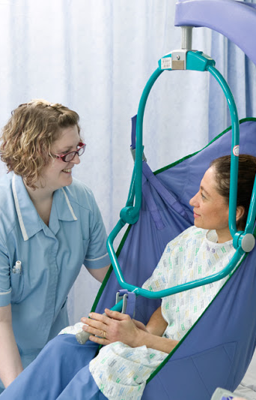
Privacy and dignity in care and support
Issues with dignity and respect will depend on your workplace. Some examples of ways in which you can work that respect individuals’ dignity are:
Ask individuals before touching them in any way
Knocking or speaking before entering the particular space or room they are in
Making sure curtains, screens or doors are properly closed before supporting a person to wash or dress
Arranging clothing or hospital gowns in a dignified way
Not making an individual wait to use the toilet or be left too long for you to return.

Slide 5
Making choices
Choice and control are key defining aspects of dignity. Involving individuals in decisions that affect them helps to promote dignity.
Day-to-day decisions
Wider decisions
Individuals must be supported to make informed decisions
by explaining:
All available options
The risks associated with the options
Implications of making the choices.
Notes:
Activity
Ask health and social care worker/s to think of some examples of day to day choices and decisions that the individual could be involved in.
Possible answers include:
When they want to get up
What they want to wear
What they want to eat
The activities they want to be involved in
Activity
Ask health and social care worker/s to think of some examples of wider decisions that the individual could be involved in.
Possible answers include:
Financial planning

Slide 6
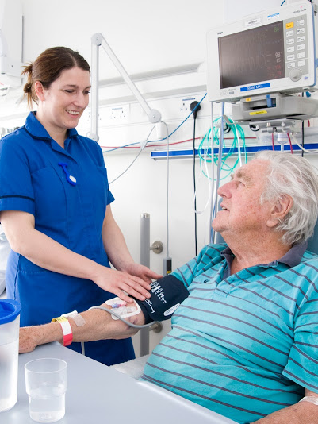
Mental Capacity Act 2005
Individuals need to be able to understand and retain the information they need to make a decision and be able to communicate
their choice
If they are not able to do this they may be assessed as lacking the capacity to make a decisions
Some individuals may have the capacity to make day-to-day decisions but not have the capacity to make more complex decisions.
Notes:
Additional information
Every effort should be made to support an individual to understand information and to communicate their choices.
Individuals can be supported to make decisions by involving other people they trust like friends or relatives. An advocate might be an additional option to help them to make a decision.
Health and social care worker’s who are not entirely sure that an individual has the capacity to make decision should seek advice and support from their manager or supervisor.
If individuals are assessed as lacking the capacity to make a decision, all decisions made on their behalf must be in their best interests.

Slide 7
Risk assessment
Risk assessment is a key part of care, support, rehabilitation or treatment plans. A five step process is recommended:
1
Identify the hazards
2
Decide who might be harmed and how
3
Evaluate the risks and decide on precautions
4
Record your findings and implement them
5
Review your assessment and update if necessary.
Notes:
Additional information
The 5 step risk assessment model is taken from The Health and Safety Executive (HSE):
www.hse.gov.uk/risk/controlling-risks.htm
If a new activity is going to be introduced, the five steps of risk assessment must be followed first.

Slide 8
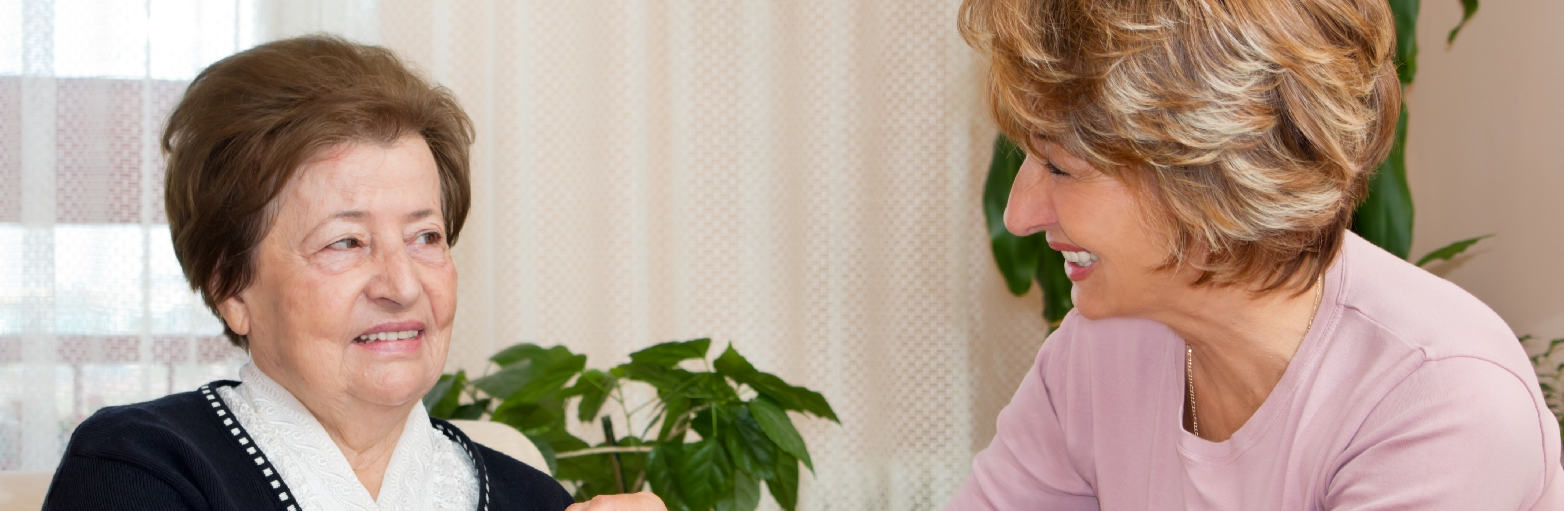
Risk enablement
It is the individual’s right to make choices and take risks once they understand the information available and are aware of the risks
Risk enablement involves supporting individuals to identify and assess risks and then supporting them to take the risks they choose.
Notes:
Additional information
There might be times when someone is unhappy with decisions that have been made on their behalf or with the choices they are offered. If this is not within your power to change you should tell them about their right to complain and support them to follow the complaints procedure.

Slide 9

Supporting active participation
Individuals must be given as much control of their life as possible as this supports an individual to build their identity and self-esteem.
Individuals have a right to participate in the activities and relationships of everyday life as independently as possible
Individual’s should be given equal opportunity of achieving their goals, valuing their diversity and finding solutions that work for them.

Slide 10


Self-care
The ability to control and care for oneself contributes to privacy and dignity. Individuals should be supported to develop self-care skills to enable them to live more independently.
Self care skills include:
Finding information
Accessing appropriate training
Participating in support
groups and networks.
Self-care
The practices undertaken by people towards maintaining health and wellbeing and managing their own care needs.

Slide 11







Knowledge check
Which of the following is a practical way of promoting an individual's privacy and dignity at work?
Click to reveal answer
Touch the individual without
asking them
Ensuring screens or doors are properly closed before supporting them to wash or get dressed
Make the individual wait to use the toilet
Walk into the room or space that they
are in without knocking or speaking first
Notes:
Trainer should ask class why they chose the correct answer.
Feedback
A – To touch a person you must enter their personal space. You should always ask the individual before you touch them in any way.
B – If your role involves supporting individuals to wash or dress make sure you protect their dignity and privacy by making sure curtains, screens or doors are properly closed.
C – If someone needs support to go to the toilet they should not have to wait or be left too long for you to return.
D – Health and social care workers should knock on the door or speak before entering the particular space or room that the individual is in.

Slide 12


Knowledge check
How can you support an individual to make an informed decision?
Click to reveal answer
By explaining the least risky options, the risks and implications
By making the decision for the individual
By telling them what you would do
By explaining all choices, risks
and implications
Notes:
Trainer should ask class why they chose the correct answer.
Feedback
A – Individuals have the right to make decisions that are risky or unwise. They should be aware of ALL options that are available to them as well as the risks and implications of each
B – Individuals must be involved in making decisions about the care and support they receive whenever possible. If a decision is difficult to make they could be supported by involving their support network or an advocate.
C – Choices are shaped by things like their background, values, culture, religion or past experiences. These are unique to the individual so a decision that is right for you may not be right for the individual. The individual should be given all available options, risks and implications and supported to make their own decisions whenever possible.
D – Health and social care workers can support individuals to make decisions by ensuring that they understand all their options and the risks and implications of making each decision.

Slide 13
Knowledge check
Which term is used to describe participation in the activities and relationships of everyday life as independently as possible?
Click to reveal answer
Self-care
Active participation
Risk assessment
Mental capacity
Notes:
Trainer should ask class why they chose the correct answer.
Feedback
A – Self-care is the term used to describe ways of working that support individuals to develop the skills to live more independently.
B – Active participation builds self-esteem and identity by working in ways that give then equality of opportunity in achieving their goals, valuing their diversity and finding solutions that work for them.
C – Risk assessment is the process of identifying risks, who could be harmed, evaluating risks and identifying precautions, recording and implementing findings and finally, reviewing the assessment and updating it when necessary
D – Mental capacity is the term used to describe an individual’s ability to retain and understand information for long enough to make a decision and to communicate their decision.

